Slide 1



blinkit
End-to-End Sales Analysis Project
Developed By – Rohit Das

Slide 2



Introduction
1
1
Blinkit (formerly known as Grofers) is a pioneer in India's quick-commerce industry, revolutionizing the way people shop for daily essentials. Founded in 2013 by Albinder Dhindsa and Saurabh Kumar, Blinkit began as a platform connecting local stores to customers. Over time, it evolved into a fast delivery service, specializing in groceries, fresh produce, household items, and more, delivering orders in as little as 10-20 minutes.
With its customer-first approach, Blinkit utilizes cutting-edge logistics, a robust network of delivery partners, and strategically located fulfillment centers to ensure a seamless shopping experience. In 2022, Blinkit joined hands with Zomato, enhancing its scale and efficiency to serve millions across India, making it a trusted name in convenience and reliability.

Slide 3



Business Requirements
2
To conduct a comprehensive analysis of Blinkit’s sales performance, customer satisfaction, and inventory distribution by performing exploratory data analysis using Python, detailed data analysis using SQL, and presenting key findings through KPIs and dashboards in Power BI.
KPI’s Requirements
Total Sales: The overall revenue generated from all items sold.
Average Sales: The average revenue per sale.
Number of Items: The total count of different items sold.
Average Rating: The average customer rating for items sold.

Slide 4

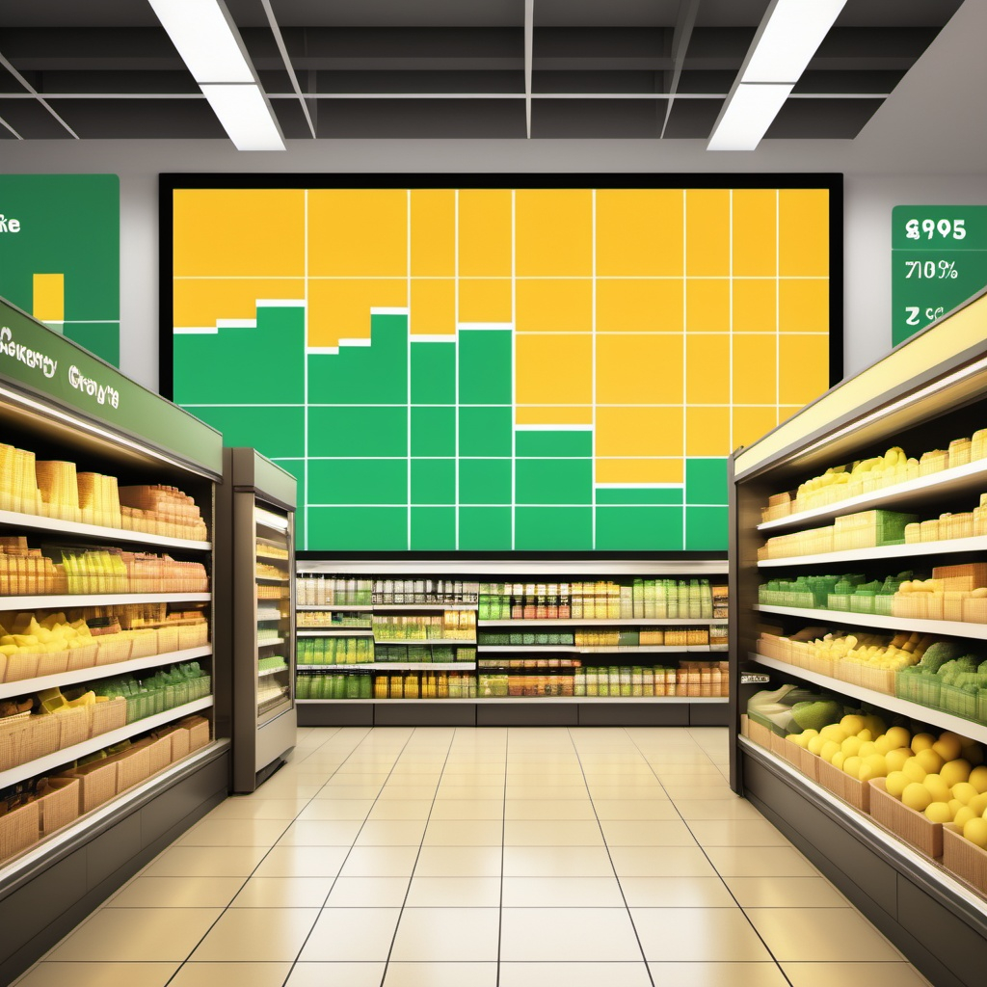
Visualization Requirements
3
Total Sales by Fat Content
Total Sales by Item Type
Fat Content by Outlet for Total Sales
Total Sales by Outlet Establishment
Sales by Outlet Size
Sales by Outlet Location
All Metrics by Outlet Type

Slide 5



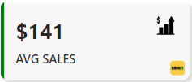
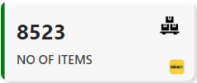
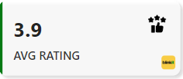
These KPI's provide an overview of sales and customer satisfaction for Blinkit
The total revenue generated from all items sold.
The total revenue generated from all items sold.
The total revenue generated from all items sold.
4
DASHBOARD (KPI’s)
The Total Revenue generated from all items sold.
The Average Revenue earned per transaction.
The Total count of items sold across all transactions.
The Average customer satisfaction rating for purchased items.

Slide 6
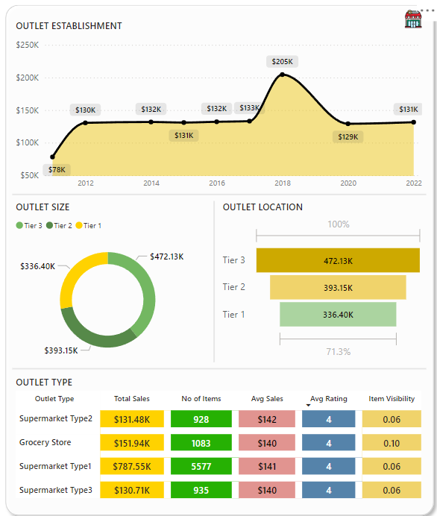
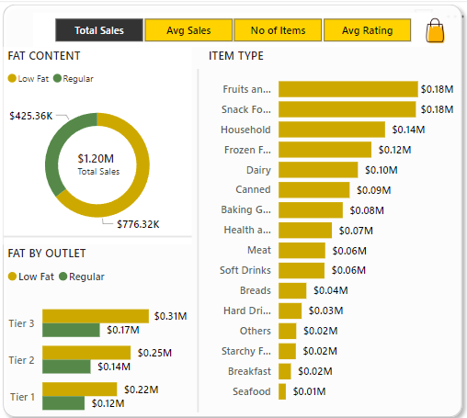

DASHBOARD VISUALS
5
Visualizing Key Metrics and Trends for Blinkit

Slide 7
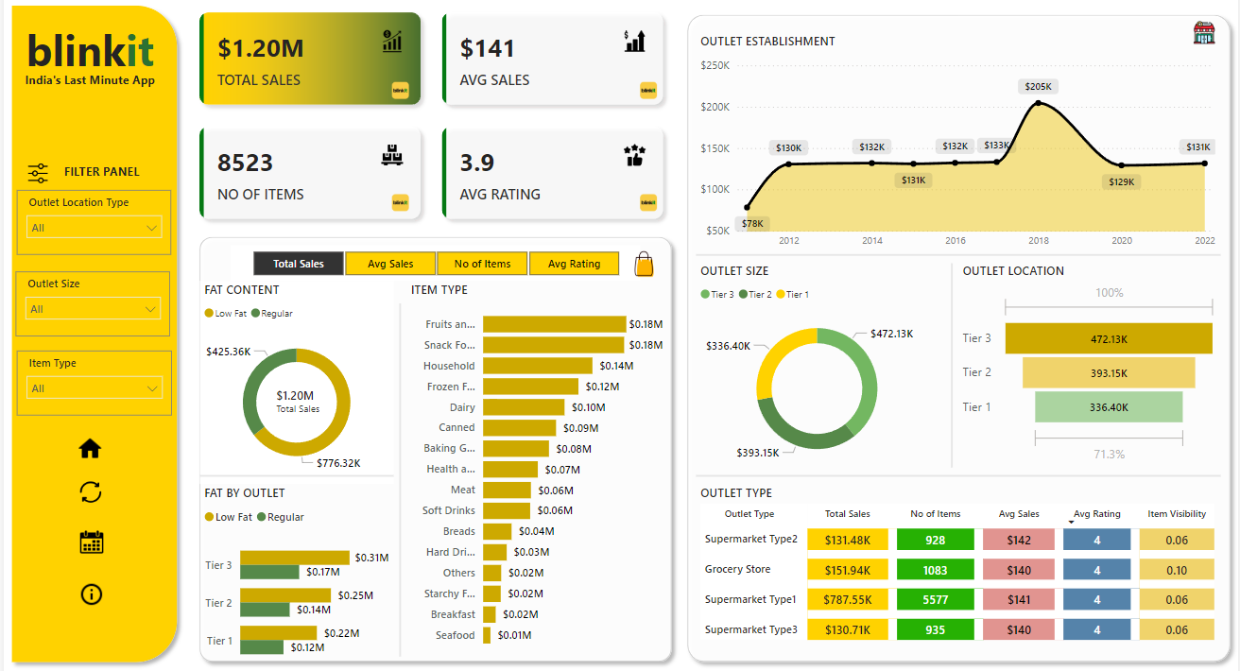
COMPLETE DASHBOARD OVERVIEW
6

Slide 8



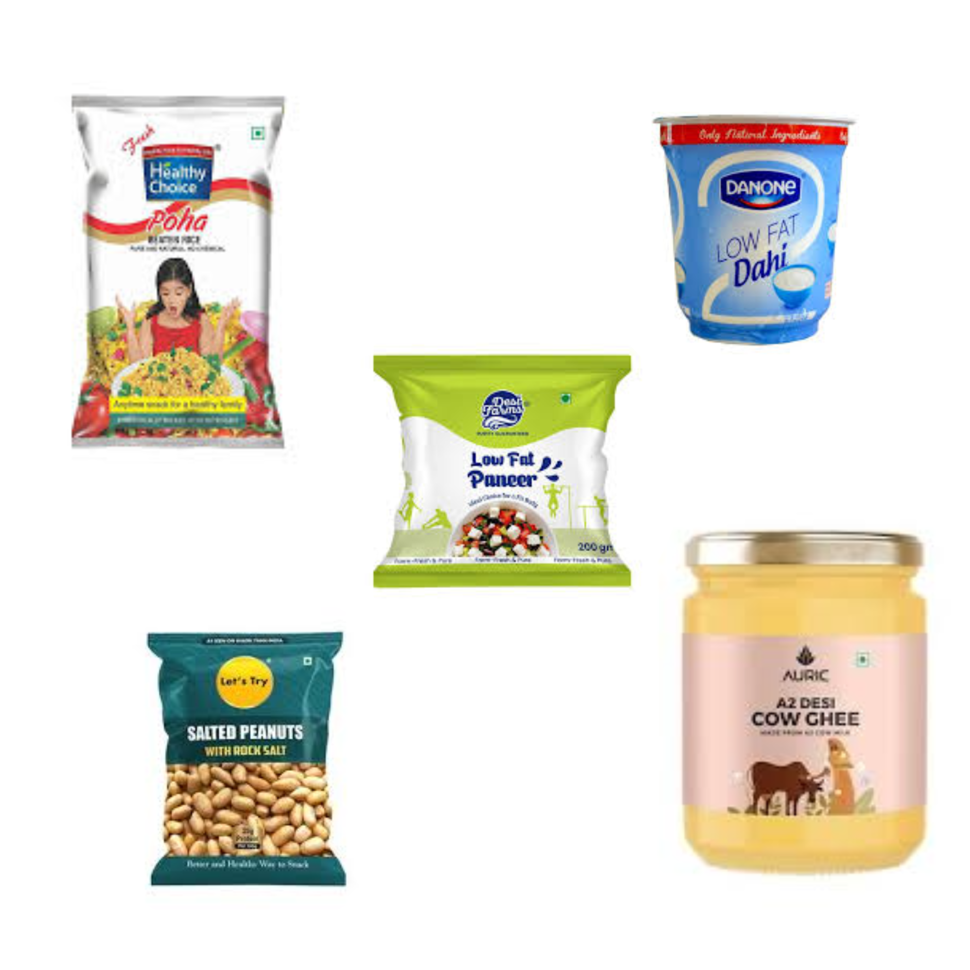

Findings
7
$0.18M
$472.13K
$776.32K
$123,456
Fruits and Vegetables are top selling
Tier 3 Locations have the highest sales
Low Fat content are preferred more
Total Revenue in 2021

Slide 9

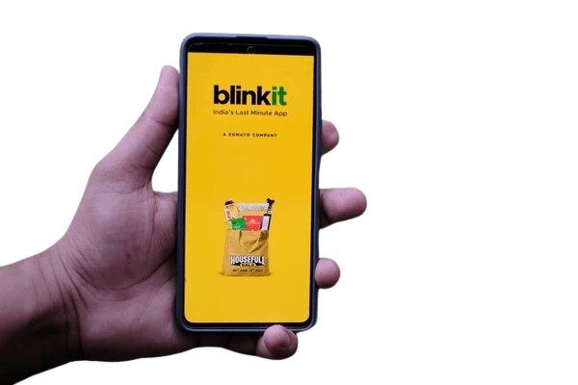
Conclusion
8
Key Insights
1
Total Sales: $1.20M, with top-performing items being Fruits & Vegetables and Snack Foods.
Tier 3 Strength: Highest sales contribution of $472.13K, highlighting strong demand in emerging markets.
Health Focus: Low-fat products generated $425.36K, showing customer preference for healthier options.
Challenges
2
Tier 1 outlets contributed the lowest sales ($336.40K).
Improve ratings and enhance product visibility in key outlets.
Categories like Seafood and Breakfast are underperforming (< $0.02M).
Recommendations
3
Boost Tier 1 Sales: Launch promotions and diversify products.
Boost Low-Performing Categories: Seasonal discounts and marketing campaigns.
Leverage Health Trends: Expand low-fat product range and target health-conscious customers.

Slide 10


Thank You

